Slide 1
Macroeconomics and Distributional Impacts in a Shock-Prone World
Lisa Kolovich, IMF

Slide 2
A quick recap…

Slide 3
Distributional Channels and Macroeconomic Outcomes
Helpful Resources:
IMF Strategy Toward Mainstreaming Gender
Integrating Gender into Macroeconomic Policies at the IMF
GDP gains and Productivity
Greater financial stability
Economic diversification
Inequality
Legal rights, education, health, financial inclusion
LFP, wages,
representation/
leadership
Macro Outcomes
Economic growth and resilience,
macro-financial stability
Policies
fiscal, monetary, structural, financial

Slide 4
Navigating a shock-prone world in this framework
A more shock-prone environment…
AI, volatile energy/commodity prices, geopolitical conflicts, natural disasters, pandemics…
…has direct impacts on growth, inflation, fiscal, BoP…
Real economy: Output contractions, employment losses, wage compression across formal/informal workers
Prices: Inflation and relative price shifts for energy/food disproportionately burden lower-income households
Fiscal: Revenue shortfalls and spending pressures create trade-offs between stabilization and social protection
External sector: Terms of trade vary by exporter status; capital flow reversals and risk premia on FX
…and households, workers, firms.
Key question: Same shock, different incidence—why?
Notes:
GDP from factor sides: External sector channels include terms of trade shocks, capital flow reversals, and risk premia increases affecting exchange rates and balance of payments with differential sectoral impacts
Real economy impacts manifest through output contractions, employment losses, and wage compression with heterogeneous effects across formal and informal workers
Price dynamics include inflation pressures and relative price changes particularly for energy and food disproportionately burdening lower-income households
Fiscal pressures arise from revenue shortfalls and increased spending demands for social protection while financing costs may rise creating difficult trade-offs
Y = GDP = W + R + π
Wages: gender gaps in wages are well-established, as well as gender bias in hiring and promotion
Rents: Property is unequally distributed between women and men and so rents are gendered
Profits: Gender biases in corporate ownership are well-established

Slide 5

Why might the same shock lead to different distributional outcomes? A few examples to consider
Transmission Channel | Heterogeneous Impact Mechanism
Consumption baskets | Energy and food shares vary systematically by income level (e.g. Amaglobelli and others 2022)
Income sources | Wages/self-employment, transfers, remittances determine inflation protection and shock resilience (e.g. Bogman and others 2021)
Sectoral exposure | Formal versus informal sector and industry concentration create differential vulnerability (e.g. Lizarazo and Tan 2025)
Financial buffers | Savings, assets, and credit access differ substantially across income distribution (e.g. IMF FAS)
Notes:
Consumption basket composition determines vulnerability as lower-income households allocate 40-60% of spending to energy, food, and transport while upper-income households allocate only 20-30%
Income source heterogeneity matters with formal wage earners often enjoying inflation indexation while self-employed and informal sector workers face greater real income compression without institutional protection
Sectoral exposure varies with workers in commodity-intensive industries facing immediate employment impacts while service sector experiences different and often delayed transmission patterns

Slide 6
How can we analyze macroeconomic and distributional impacts of shocks?

Slide 7
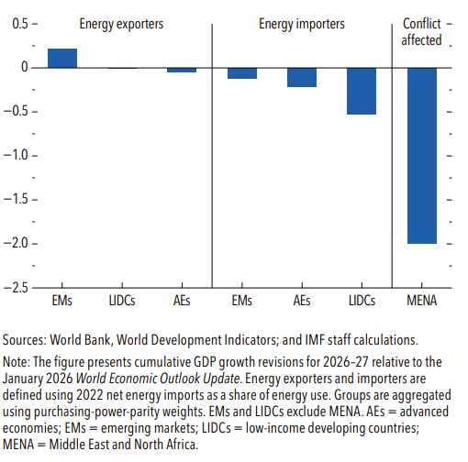
IMF growth projections are broadly lower considering recent shocks.
GDP Growth Revisions (percentage points)
Lower-income commodity-importing economies are projected to be hit particularly hard through higher energy and food prices as well as foreign exchange depreciation.
April 2026 World Economic Outlook: Global Economy in the Shadow of War

Slide 8
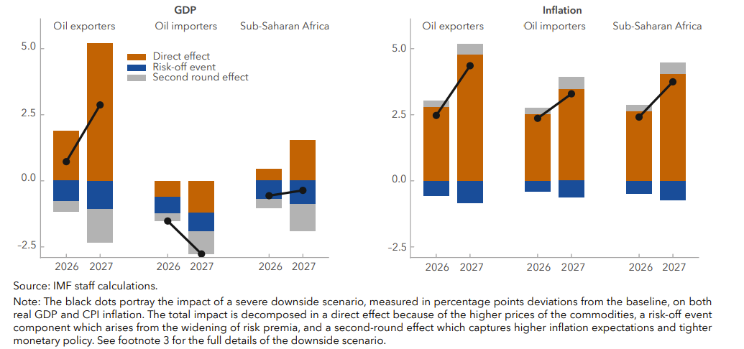
In SSA, projections point to lower growth and higher inflation under more severe shock scenario
Additional Impact on GDP Growth and Inflation from Severe Scenario
(percentage points deviation from baseline)
Global slowdown reduces regional output by –0.6% (2026) and –0.4% (2027) vs. baseline
Oil exporters: GDP gains from higher prices, partly offset by tighter financing and spillovers
Oil importers: Output declines –1.5 pp (2026) and –2.8 pp (2027)
Inflation pressures: Regional inflation rises +2.4 pp (2026) and +3.8 pp (2027)
Source: IMF April 2026 Sub-Saharan Africa Regional Economic Outlook

Slide 9
Let’s explore three possible shocks in greater detail…
Archetypes and examples of transmission channels
1. Energy/commodity price spike
Higher inflation and real income compression
2. Conflict/geopolitical disruption
Supply disruption, heightened uncertainty, and potential displacement
3. Technology/AI diffusion
Productivity gains and labor reallocation
Notes:
Let me start with the drivers of gender inequality.

Slide 10

Example 1: Energy Price Shock
Starting point for analysis could include…
Macroeconomic considerations:
Inflation
Fiscal cost of price measures
Current account
Growth
Distributional considerations:
Higher burden on low‑income households if energy, transport, or food shares are larger
Informal workers face limited wage indexation; real wages compress
Policy design:
Protect vulnerable with targeted measures where feasible; limit broad untargeted subsidies when fiscal space is tight.

Slide 11
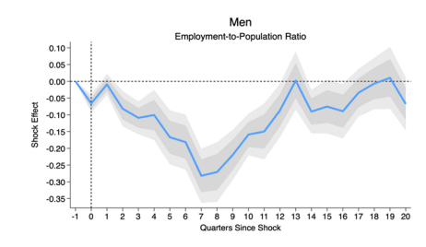
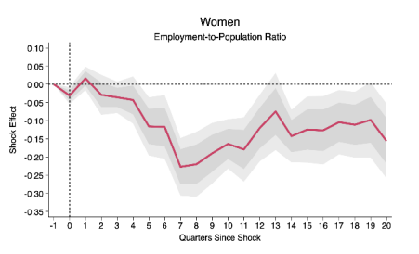
IMF Research on Oil Price Shocks and Labor Market Disparities
Both men and women see employment declines after the oil shock, with effects deepening through the first 6–8 quarters.
Men experience a larger initial drop, reaching about -0.25 pp, but show a clear recovery starting after ~8 quarters.
Women also experience a significant decline (-0.2 to -0.25 pp), but recovery is slower and remains persistently negative over the full horizon.
Gender employment gap temporarily narrows post-shock, peaking around quarter 8, as men are more affected initially; the gap then fades as men recover faster than women.
Source: Oil Shocks and Labor Market Developments, IMF Working Paper No. 2025/145, July 18, 2025

Slide 12
(cont.) Heterogeneous Impacts: Oil Importers versus Exporters and Sectoral Differences
Category | Employment-to-Population Ratio | Unemployment Rate | Labor Force Participation Rate
Baseline | Sharp decline with partial recovery; remains below baseline | Rapid rise with slow decline; remains elevated | Mild decline; volatile, partial rebound
Net Oil Importers | Sharp drop, partial rebound; remains below baseline | Rapid increase, slow recovery; stays elevated | Persistent decline
Net Oil Exporters | Gradual increase, peaks later | Mild increase, returns to baseline | Steady increase over time
Sectoral Analysis – Oil-Intensive | Immediate, sharp drop; remains below baseline long term | Not available | Not available
Sectoral Analysis – Oil-Moderate | Delayed decline; persistent medium- and long-term drop | Not available | Not available
Notes:
Oil-importing countries show clear employment declines with men more affected initially but greater long-term female losses [2]
Oil-exporting countries exhibit modest short-term losses followed by long-term gains with minimal gender gap changes [2]
Oil-intensive industries experience steep employment declines with women facing disproportionately larger long-term impacts [2]
Oil-moderate sectors show parallel decline patterns for both genders resulting in minimal gender gap changes

Slide 13
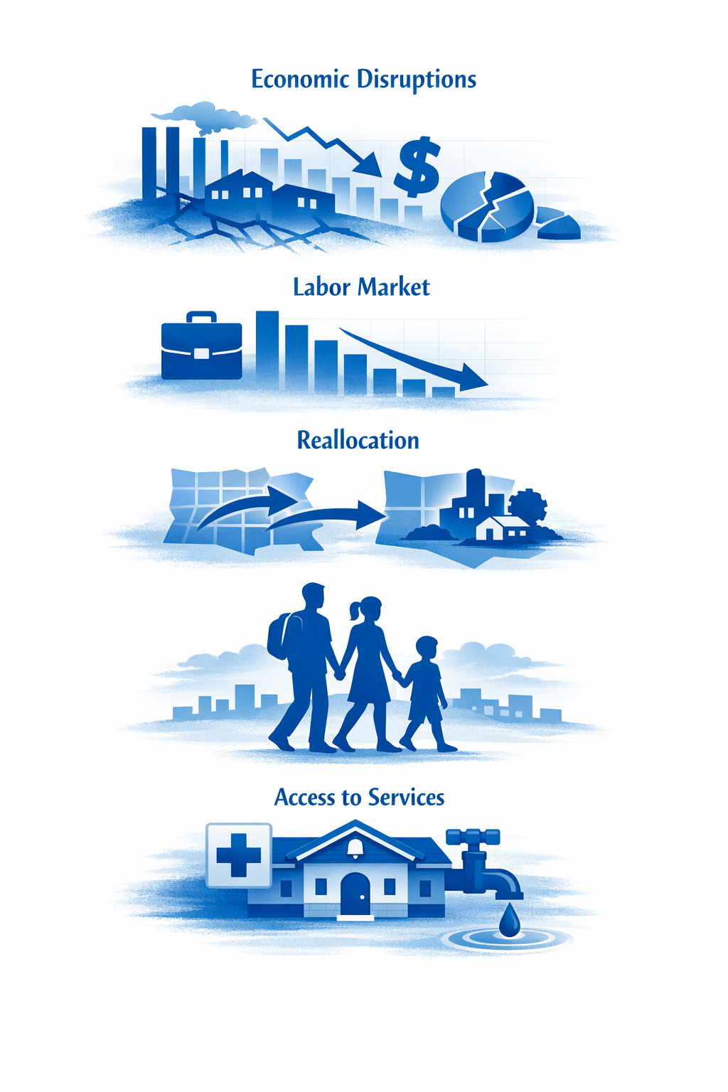
Example 2: Conflict/Geopolitical Shock
Starting point for analysis could include…
Macroeconomic considerations:
Real: production/trade disruptions; supply constraints
Fiscal: spending pressures (security, humanitarian, reconstruction)
Financial: risk premia, capital outflows, FX pressures
Distributional considerations:
Displacement
Job loss concentrated in specific regions/sectors
Unequal/unavailable access to services
Policy design:
Protect vulnerable with targeted measures where feasible; limit broad untargeted subsidies when fiscal space is tight.

Slide 14
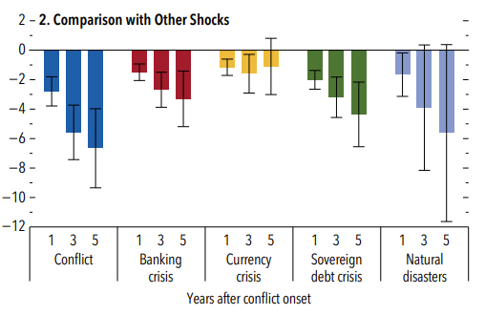
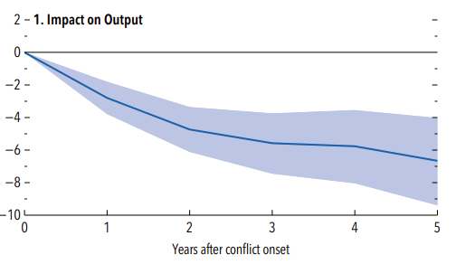
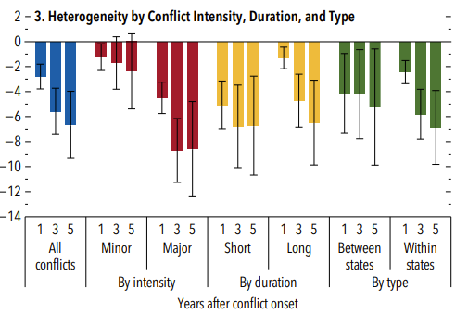
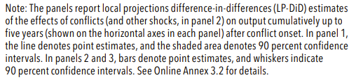
Economic Costs of Conflict
Source: IMF April 2026 World Economic Outlook

Slide 15
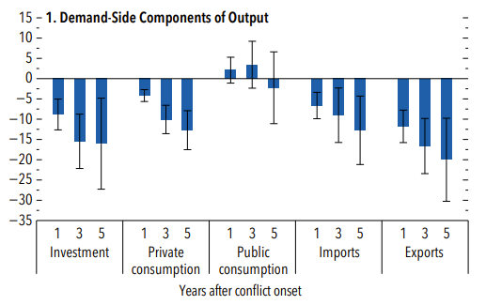
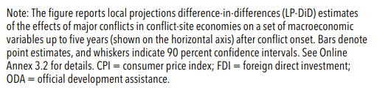
Macroeconomic Tradeoffs of Major Conflicts
Let’s Discuss… What might be some of the distributional impacts that we could see in the demand side components?
Source: IMF April 2026 World Economic Outlook

Slide 16

Example 3: Technology/AI
Starting point for analysis could include…
Macroeconomic considerations:
Productivity and potential output gains
Sectoral shifts and reallocation of activity across industries
Transition dynamics affecting employment and wage growth
Distributional considerations:
Skill and occupation exposure varies (routine vs. non‑routine tasks)
Transitional unemployment and earnings losses may concentrate in exposed groups
Gaps may widen where digital infrastructure and access are uneven
Policy design:
Scale up reskilling and job‑matching programs, and deploy targeted, temporary support to facilitate worker transitions while preserving macroeconomic stability.

Slide 17
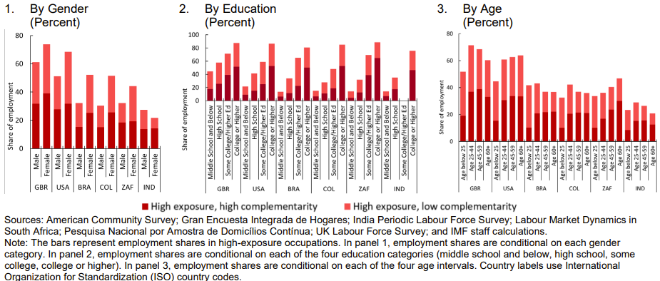
Women and higher‑educated workers are more exposed to AI, but more likely to benefit where jobs are complementary.
Source: IMF Gen AI: Artificial Intelligence and the Future of Work

Slide 18
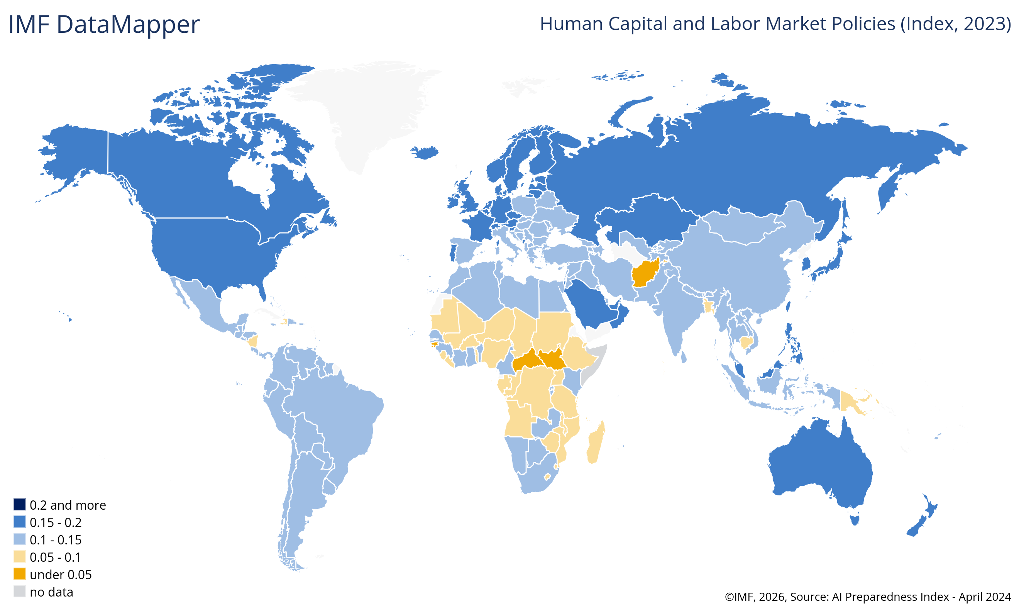
AI Preparedness Index
Under most scenarios, AI will likely worsen overall inequality, a troubling trend that policymakers can work to prevent.
Countries with stronger AI preparedness are more likely to see net gains, while those with lower preparedness may face greater risks of labor market disruption and widening gaps.
See Gen AI: Artificial Intelligence and the Future of Work
Source: IMF AI Preparedness Index

Slide 19
Putting it all together…
Notes:
Let me start with the drivers of gender inequality.

Slide 20

Macroeconomic Analysis and Policies with Distributional Awareness
Diagnose shock type and affected macro blocks
Shock diagnosis identifies disruption sources and affected macro blocks including
external sector, real economy, prices, fiscal accounts, and financial conditions
Identify incidence channels and exposed groups
Incidence analysis determines exposure through consumption patterns, income sources, sectoral concentration, and buffer availability for targeted responses
Design policy instruments
Align instruments with macroeconomic objectives (price stability, debt sustainability, external balance) and distributional goals while also considering capacity and implementation constraints

Slide 21
Questions for discussion:
Pick one shock your country has faced recently:
What were the main macro effects (growth/inflation/fiscal/BoP)?
Who was hit hardest and through which incidence channel?
What policy response worked—or did not—and why?
Notes:
Let me start with the drivers of gender inequality.

Slide 22
Thank you
Notes:
Let me start with the drivers of gender inequality.

Slide 23
Extra Slides
Notes:
Let me start with the drivers of gender inequality.

Slide 24
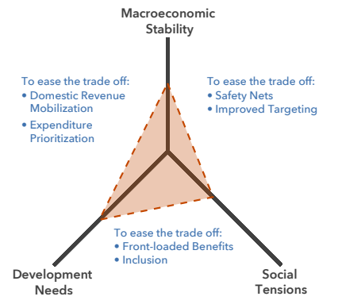
Policymaker’s Trilemma
Sub-Saharan Africa has made considerable progress addressing macroeconomic imbalances, but authorities now need to take into account a fast-changing global environment with significant uncertainty.
Source: IMF April 2025 Regional Economic Outlook

Slide 25
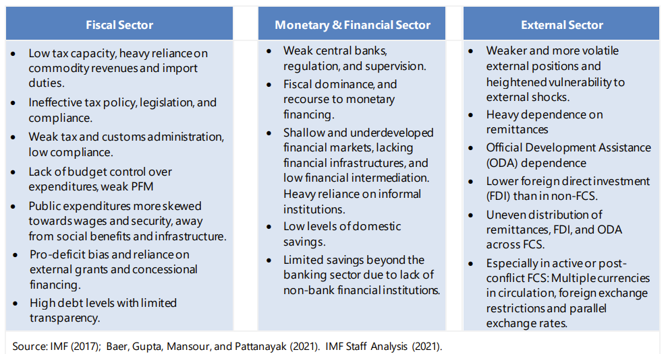
Consider macroeconomic policy challenges in fragile and conflict-affected states
See also The IMF Strategy for Fragile and Conflict-Affected States

Slide 26
Measurement and Monitoring: Examples
Category | Examples of Key Indicators
Prices | Food and energy inflation plus regional dispersion
Labor | Employment and unemployment by sector age and sex
Households | Real income and consumption by decile from surveys
Social protection programs | Social assistance coverage adequacy and take-up rates
Move beyond headline inflation to track food and energy separately given disproportionate impact on lower-income households; geographic heterogeneity
Labor indicators disaggregated by sector age and sex provide early warning signals of differential impacts; can also consider informality
Household welfare metrics from high-frequency surveys track real income and consumption changes across deciles enabling assessment of policy responses
Program effectiveness monitoring evaluates social assistance coverage adequacy and take-up rates to ensure interventions reach intended beneficiaries

